Slide 1

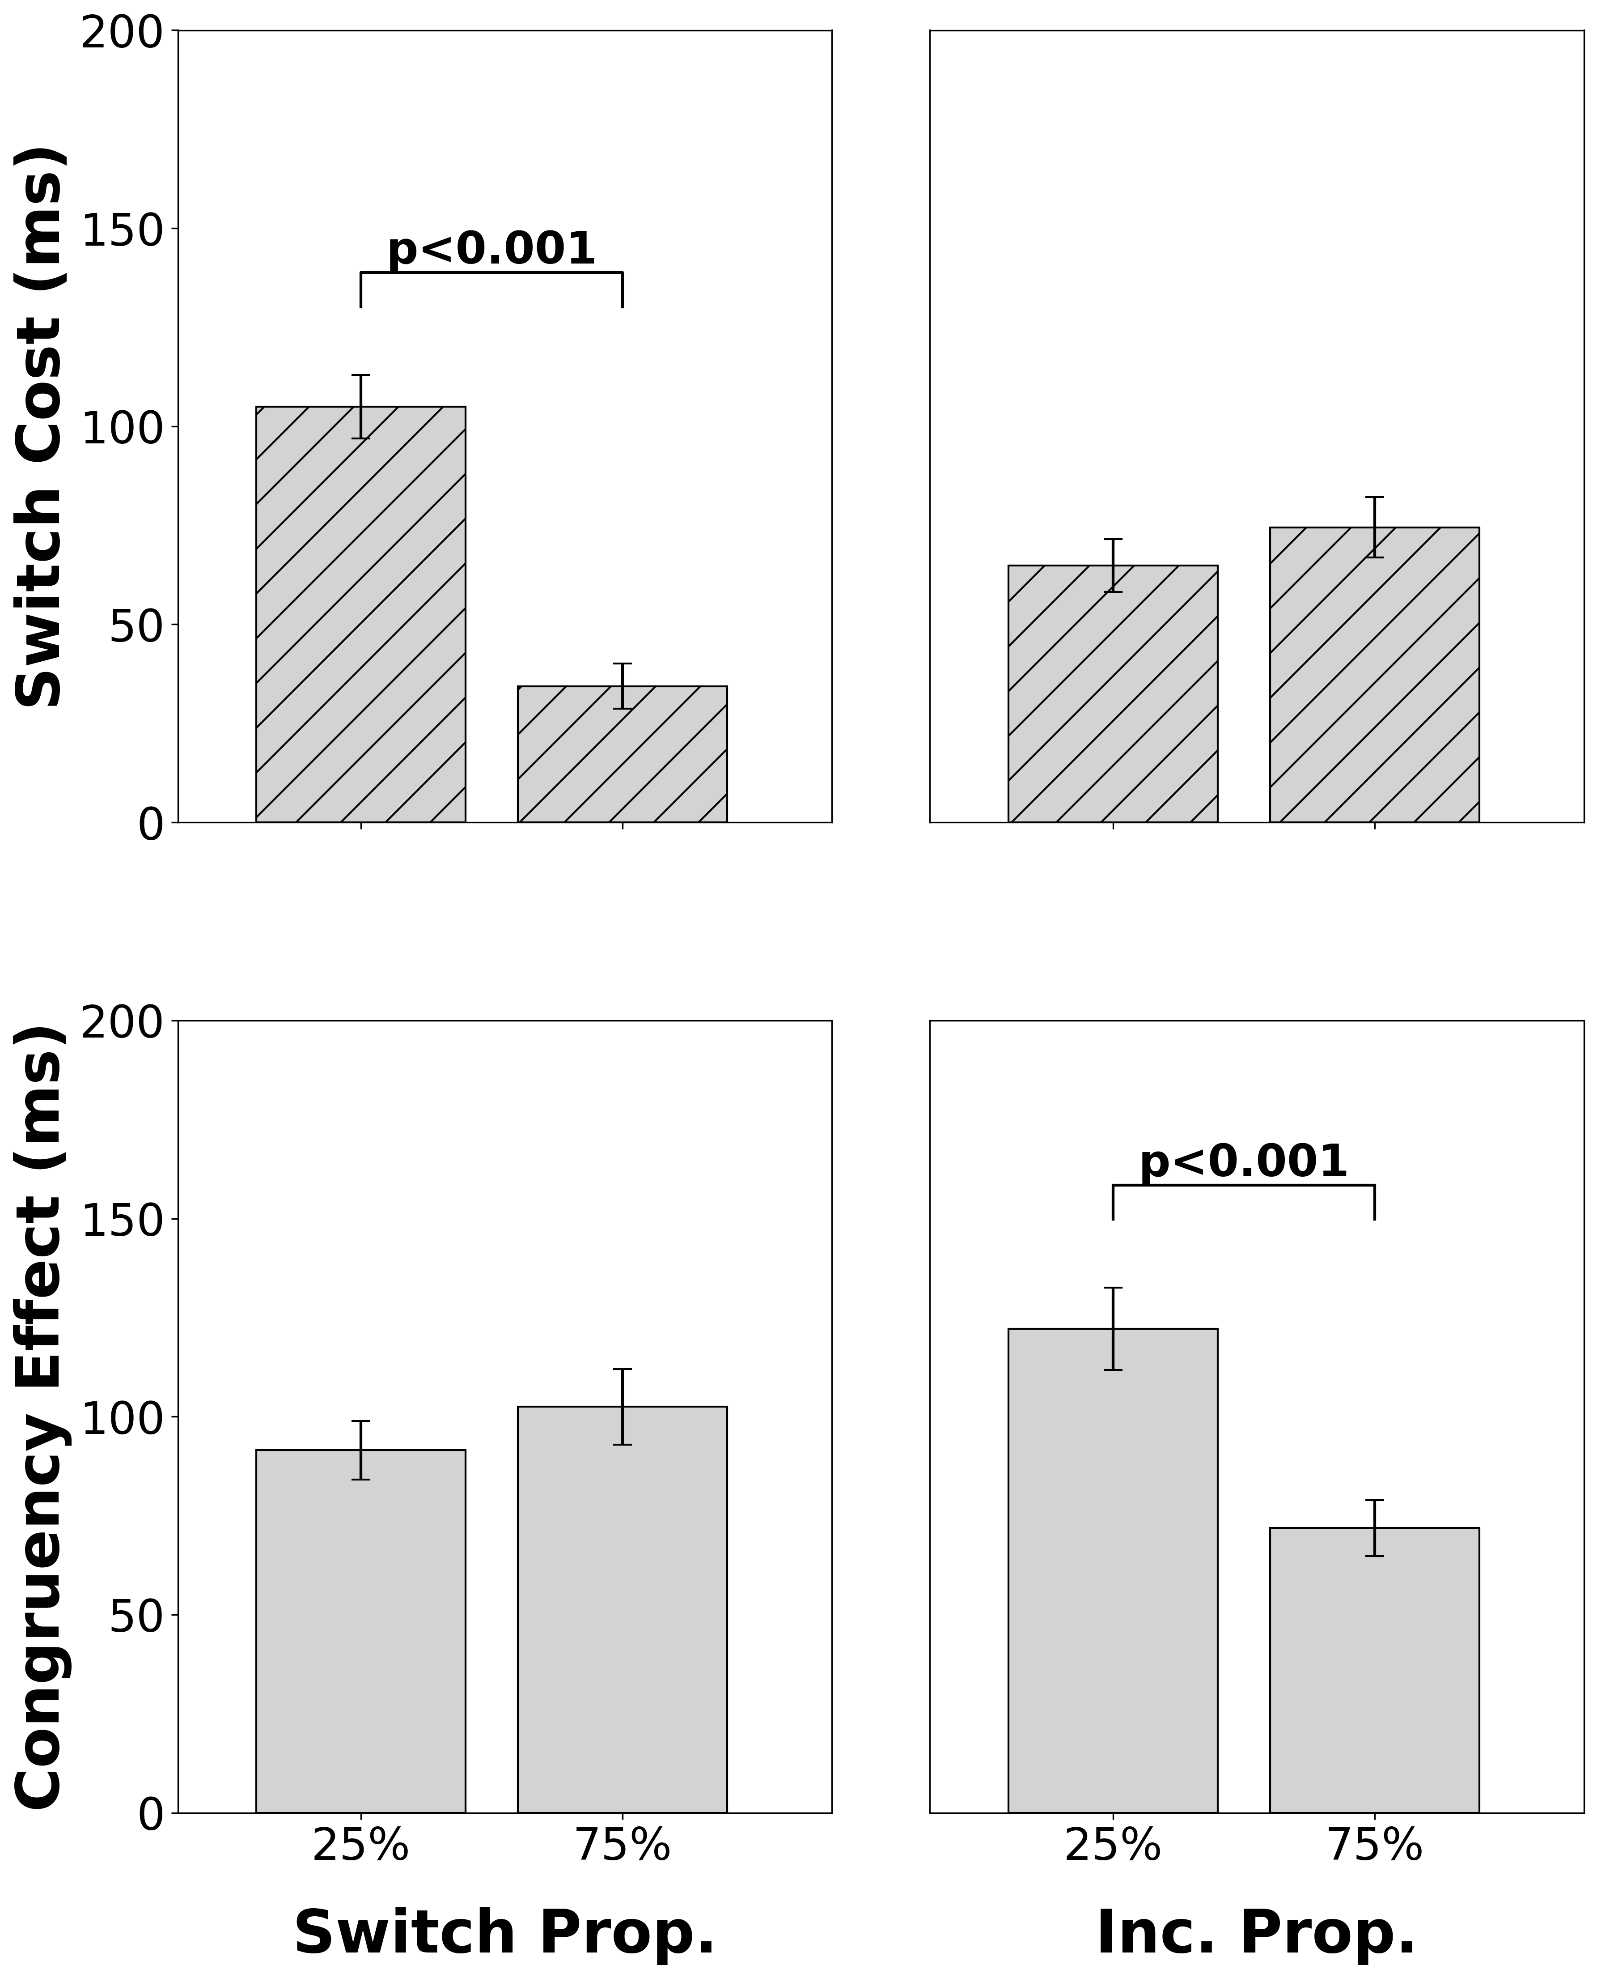
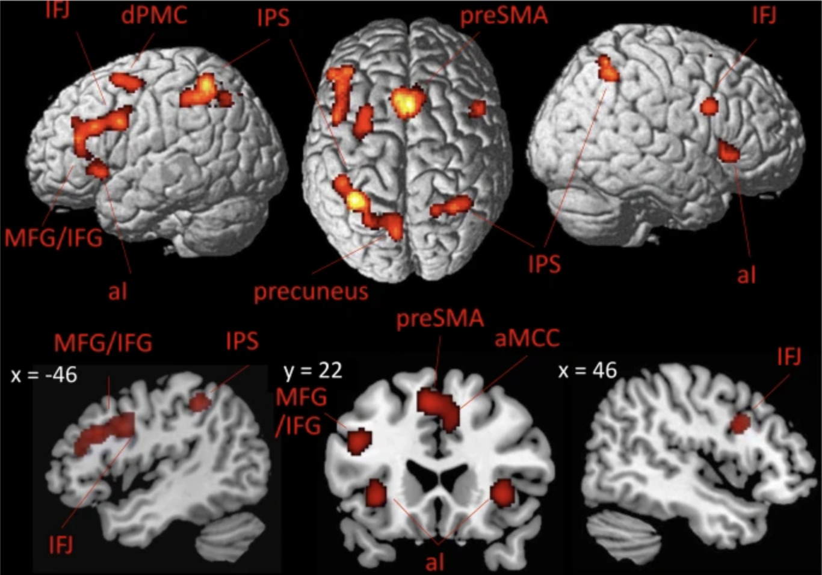
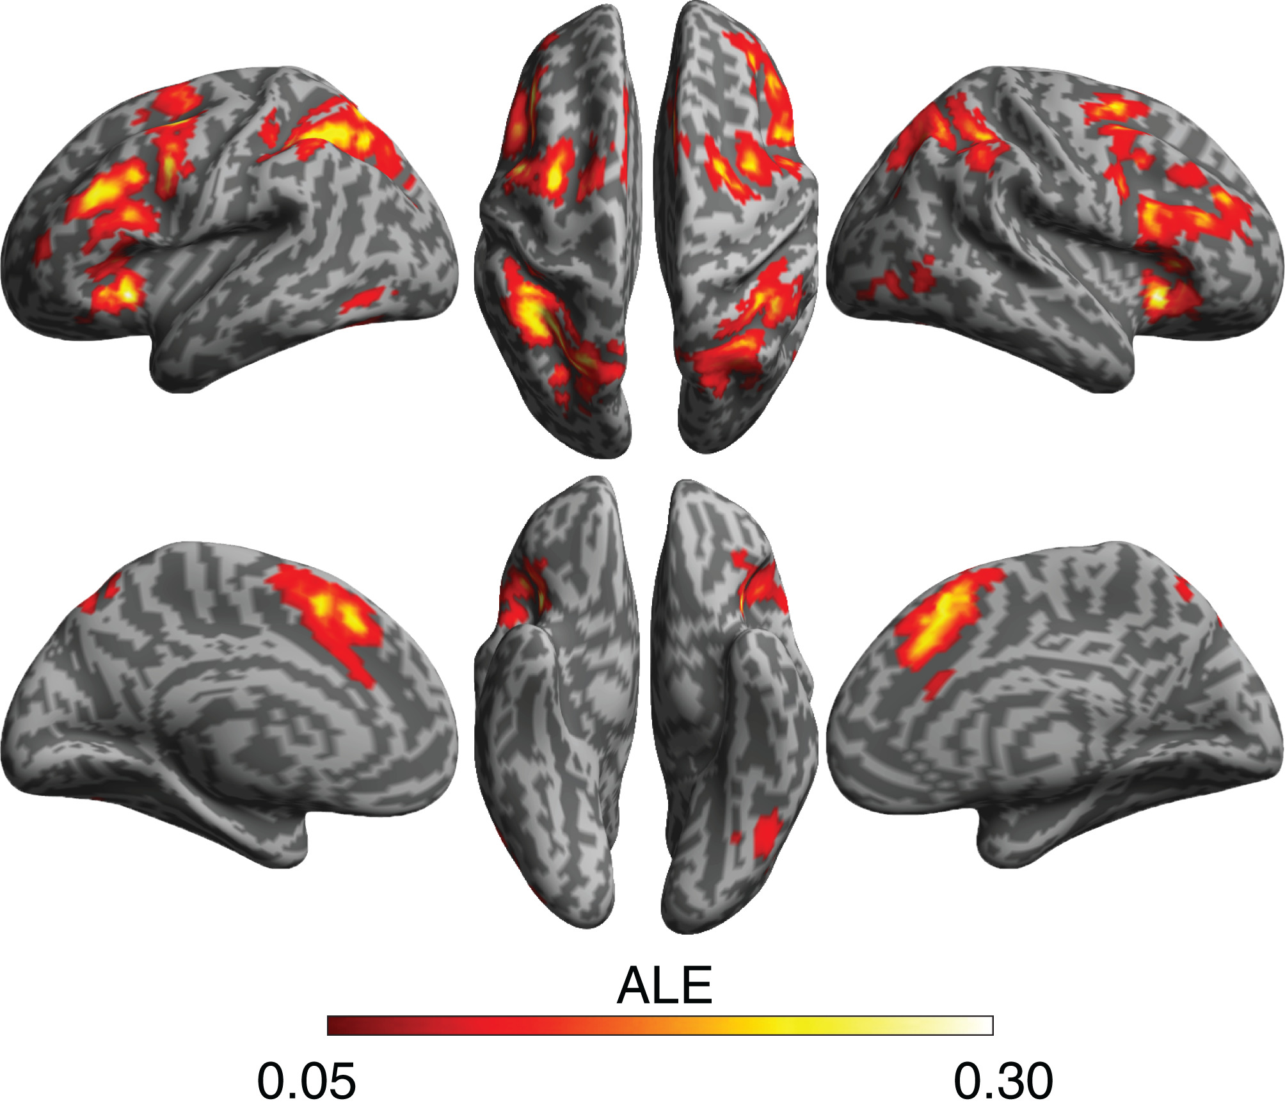
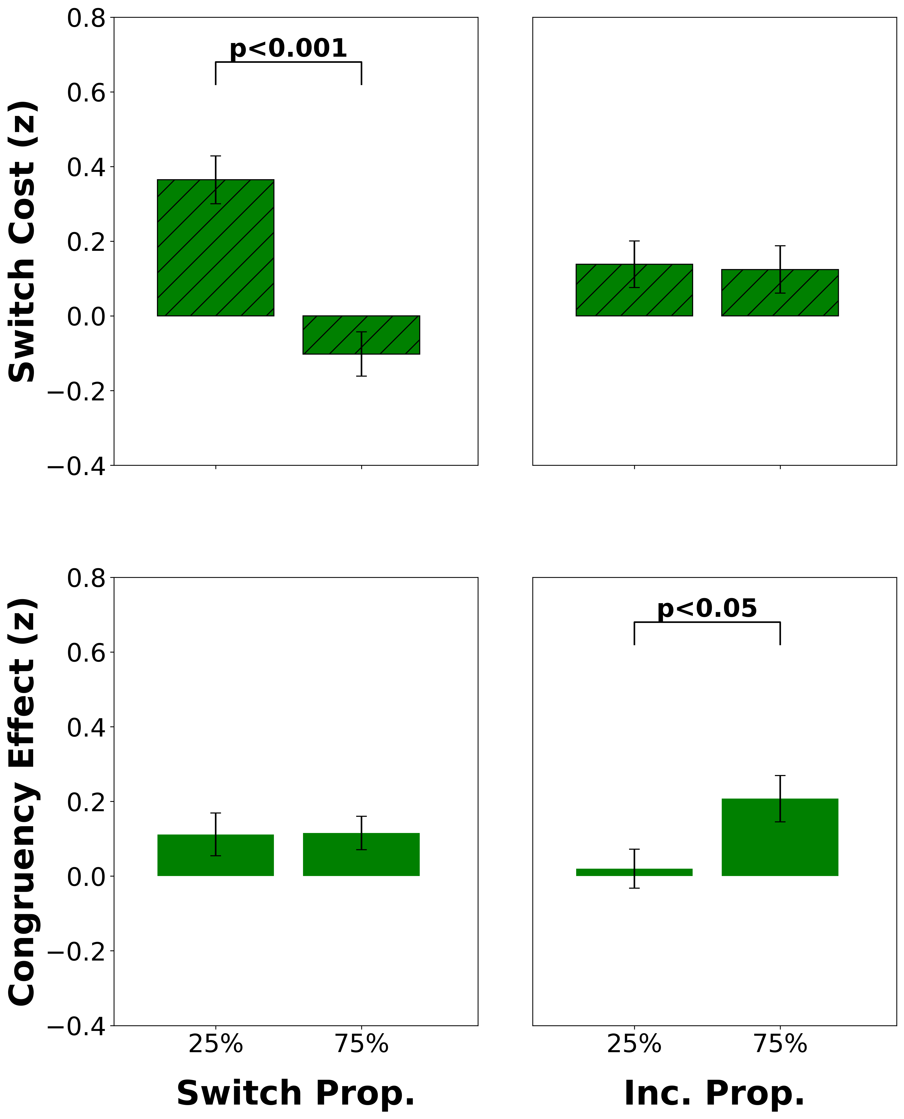
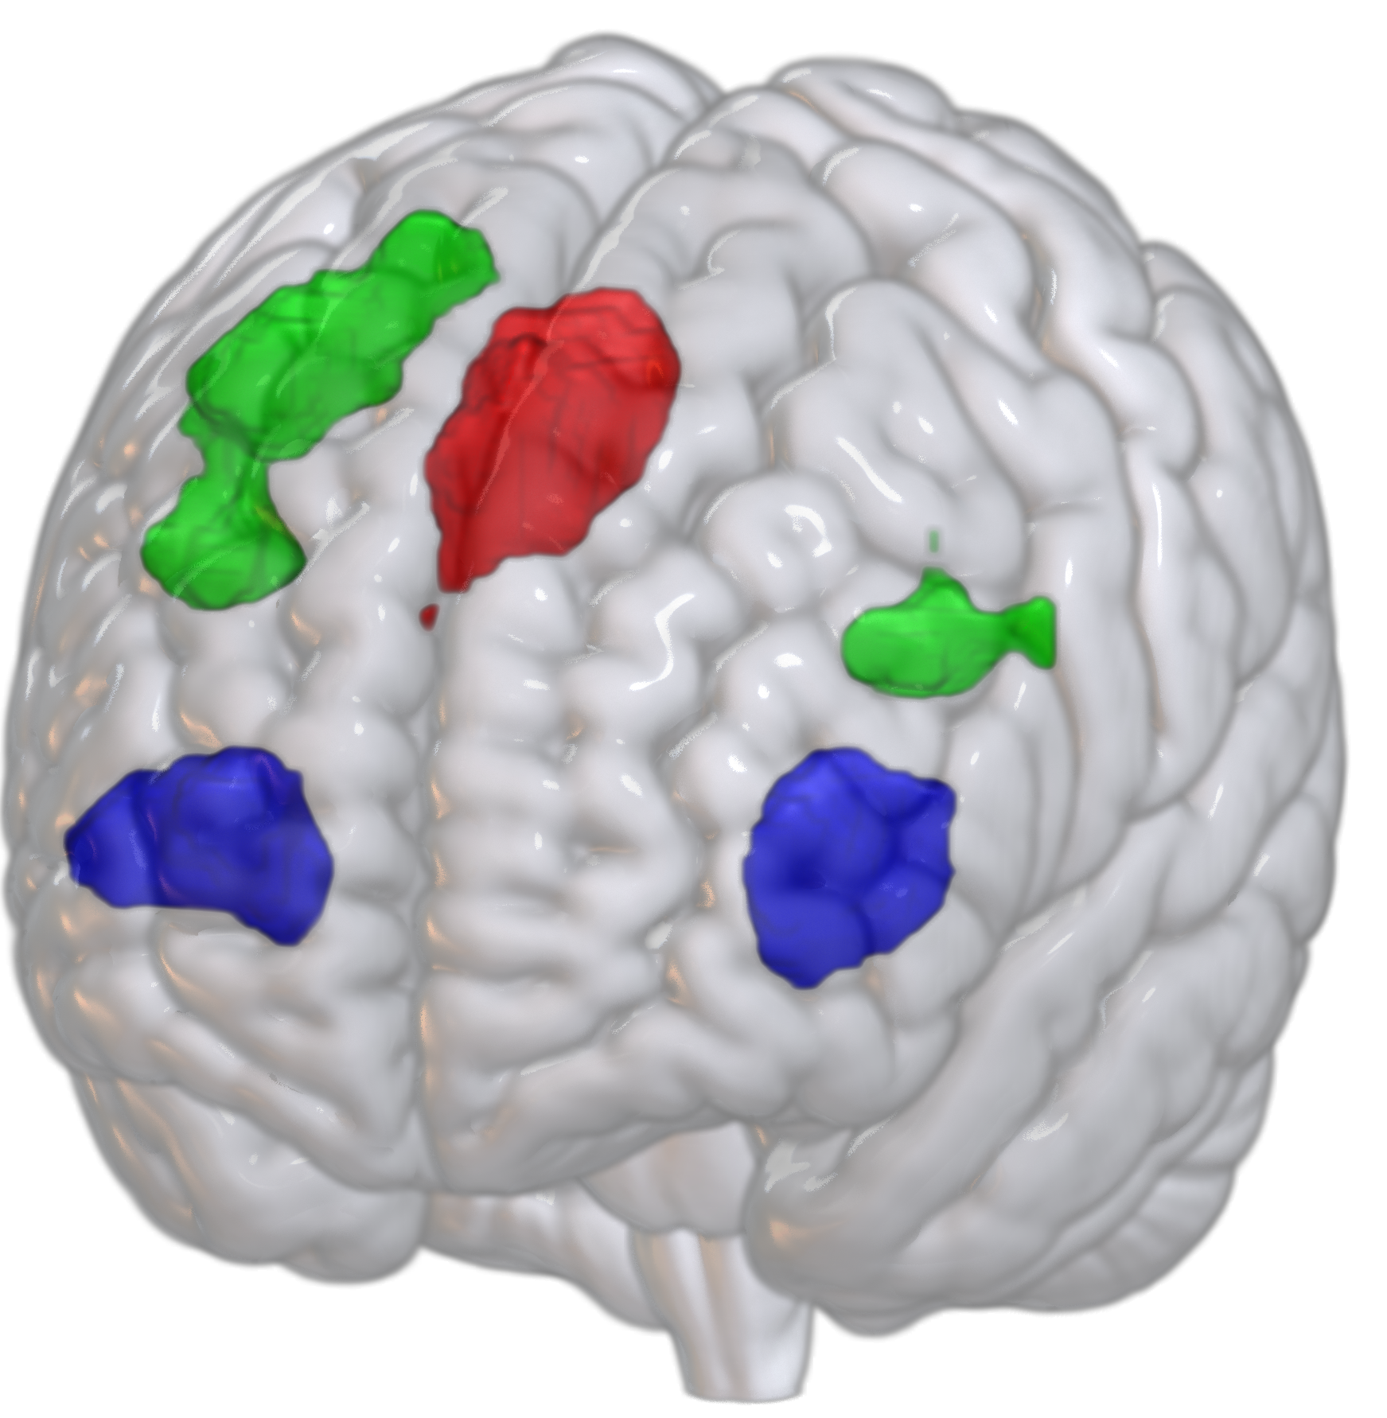
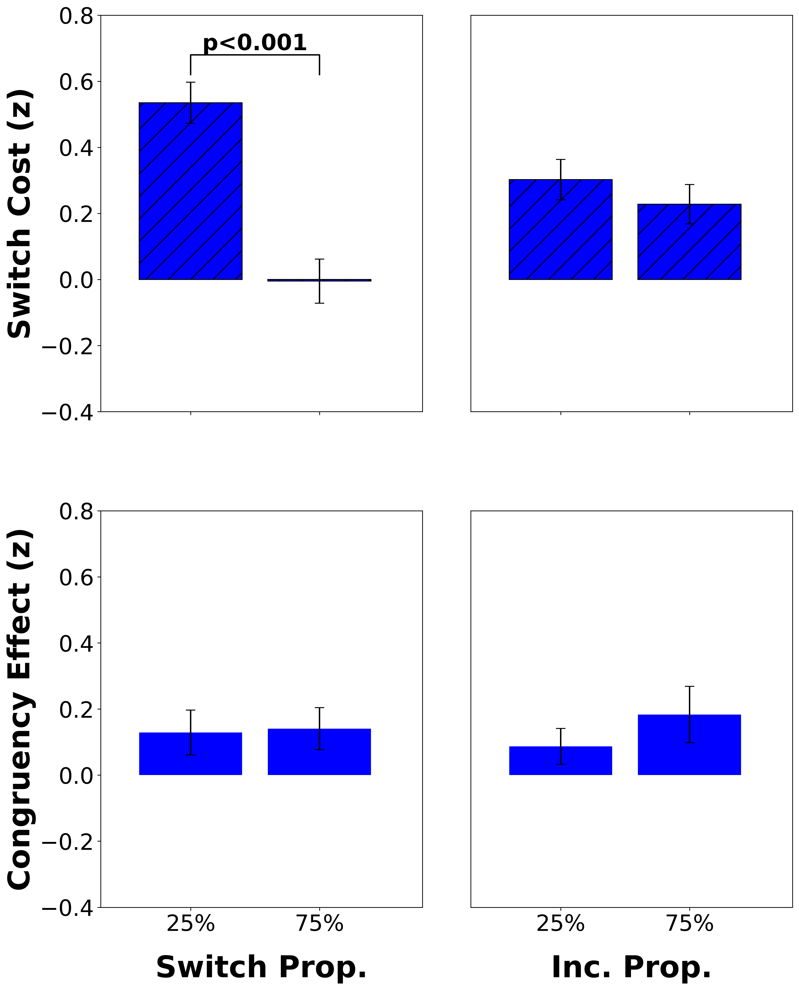
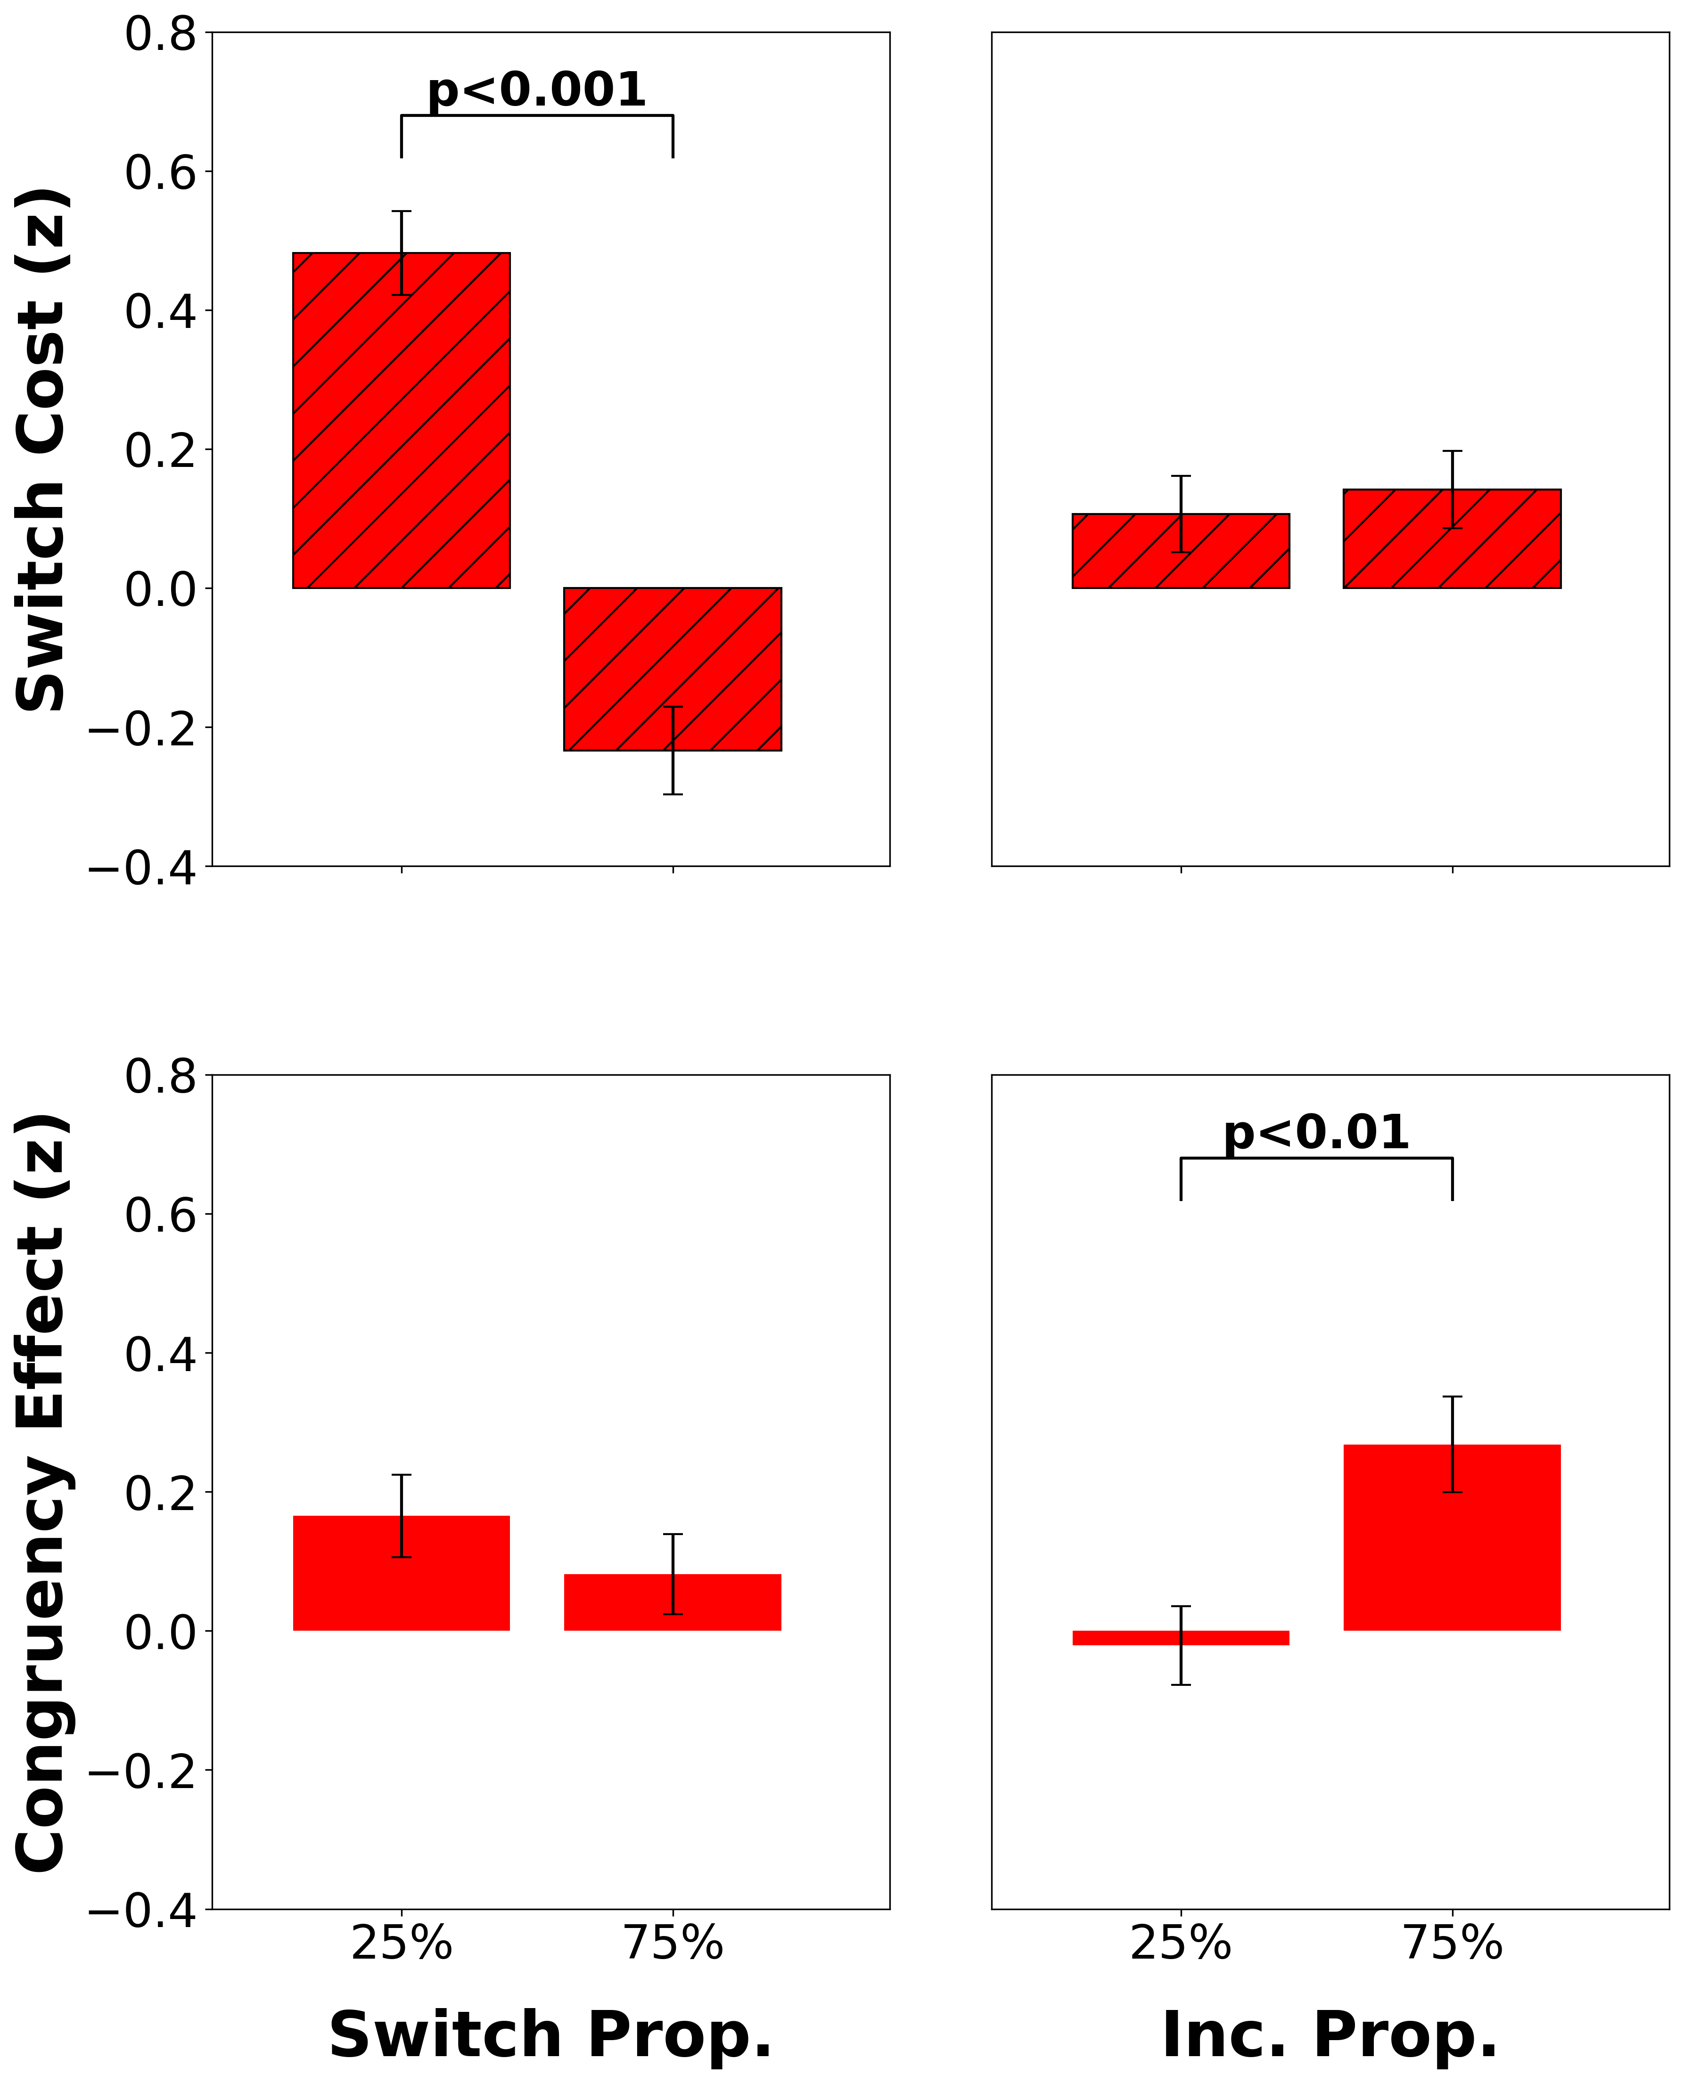

Intracranial EEG Correlates of Concurrent Demands on Cognitive Stability and Flexibility
Neural Correlates of Concurrent Demands on Cognitive
Stability and Flexibility
Jinjiang Zhang^{1,2}, Raphael Geddert^{1,2}, Roshni Ammanamanchi^{1,2}, Andrew Michael², Tobias Egner
Department of Psychology and Neuroscience¹, Center for Cognitive Neuroscience²
Duke University
Background
Behavioral Results
Discussion
Cognitive stability (task focus) and flexibility (task switching) are two core capacities of cognitive control, yet their relationship and neural substrates are unclear^{1,2}
Previous studies have separately shown activation for stability and flexibility in lateral and medial frontal cortex^{3,4}, but whether they have distinct or shared neural substrates is still not known
Do cognitive stability and flexibility have distinct or shared neural substrates?
Listwide Proportion Switch Effect (LWPS): Switch proportion modulates switch cost
Incongruent proportion modulates congruency effect
vlPFC uniquely sensitive to flexibility demands, while ACC and dlPFC show sensitivity to both stability and flexibility demands
Prefrontal areas show an adjustment based on the cognitive context (proportion effects) rather than just responding to trial-level demands
Absence of cross-domain effects suggests independence in how stability and flexibility are regulated neurally
Representational similarity analysis did not show significant multivariate patterns, potentially need alternative multivariate approaches (e.g., MVPA)
Future work should investigate connectivity patterns between regions and brain-behavior correlations
Some regions (ACC/dlPFC) may integrate domain-general control demands while others (vlPFC) may be more domain-specific
25%
75%
25%
75%
25%
75%
25%
75%
Neural Substrates of Flexibility³
Neural Substrates of Stability⁴
Switch Prop. Incongruency Prop.
Switch Prop. Incongruency Prop.
Brain Regions Modulating Flexibility
We identified brain regions mediating cognitive flexibility (via the LWPS) and probed their response to concurrent stability demands
dlPFC independently adjusts stability and flexibility
Study Design
Participants completed a classic cued task switching experiment (n=45).
Repeat
Switch
Red Frame: Odd or Even
2
7
1
…
Conclusion
Blue Frame:
< 5 or > 5
Congruent
Incongruent
Our findings suggest cognitive stability and flexibility rely on partially dissociable neural pathways, with vlPFC specifically supporting flexibility while ACC and dlPFC seem to support both control processes.
This functional specialization could help explain how the brain manages concurrent demands on task focus and task switching.
< 5
even
> 5
odd
👉🏽
< 5
even
> 5
odd
👉🏽
👈🏽
👈🏽
vlPFC adjusts flexibility
ACC independently adjusts stability and flexibility
Switch costs index flexibility (RT_{switch} – RT_{repeat})
Congruency effects index stability (RT_{inc} – RT_{con})
75%
Block A
64 Trials
Block B
64 Trials
The proportion of incongruent and switch trials varied independently across block types (2 blocks per functional run, 4 runs total)
Switch Prop.
References
25%
Block C
64 Trials
Block D
64 Trials
Egner 2023, Nat Rev Psychol.
Geddert and Egner 2022, Journal of Experimental Psychology.
Worringer et al. 2019, Brain Struct Funct.
Wu et al. 2020, J Comp Neurol. Thanks to all members of the Egner lab for their guidance and support on this project
This work was funded by NIH Grant RO1 MH133550
25%
75%
Incongruent Prop.
Analyses and standard preprocessing conducted in FSL.
Cluster-forming threshold of z=2.3 and cluster significance threshold of p=0.05.
Event-related modelling used for task conditions.
CONTACT
jim.zhang@duke.edu
CONTACT
jim.zhang@duke.edu

